Slide 1
Roll call systems
Pham Huy Hoang
Nguyen Quoc Huy
Nguyen Thanh Binh

Slide 2
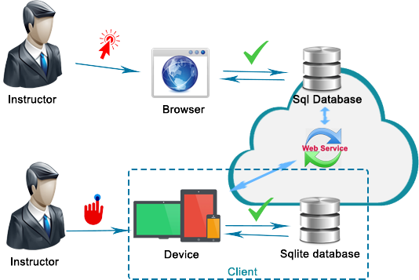
Process

Slide 3
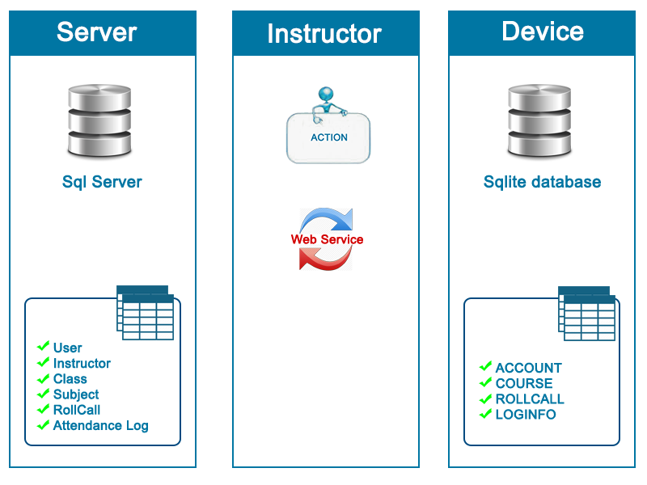
Managements data sync

Slide 4
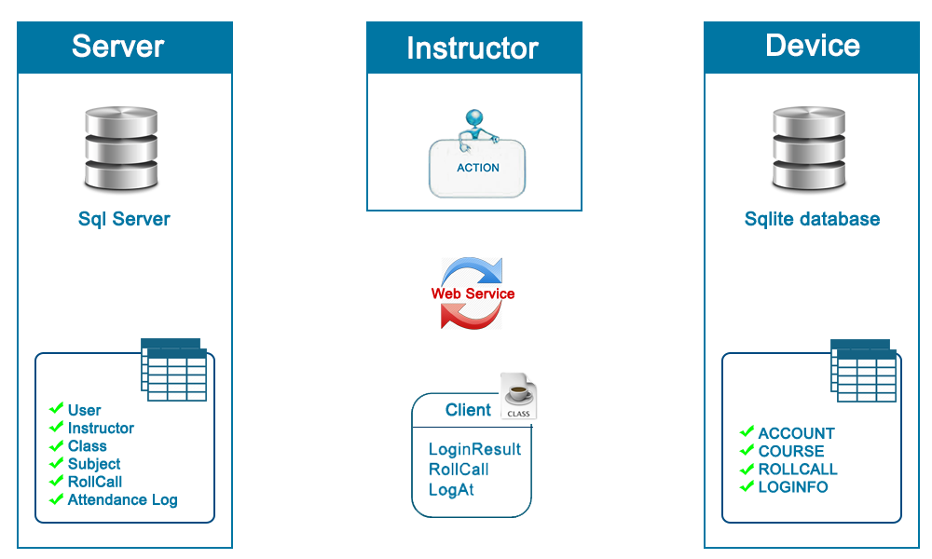
Managements data sync

